Slide 1
Cilk: An Efficient Multithreaded Runtime System
Notes:
C-based runtime system for multithreaded parallel programming

Slide 2

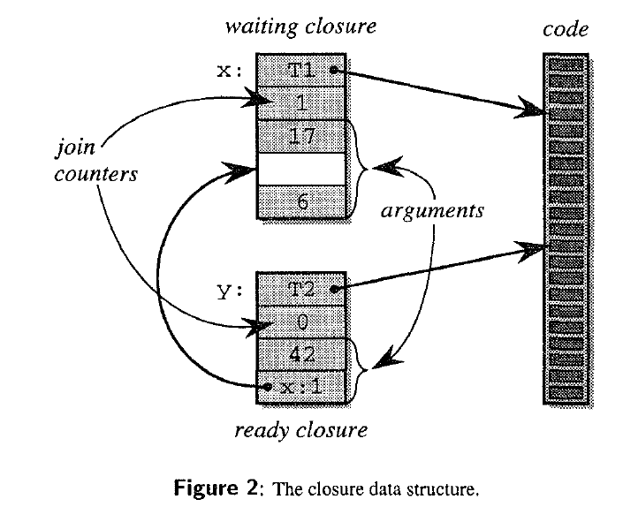
Closure & Continuation
Translate into C function with:
Closure Data Structure
Void Return Type
Continuation for Data Dependency

Slide 3
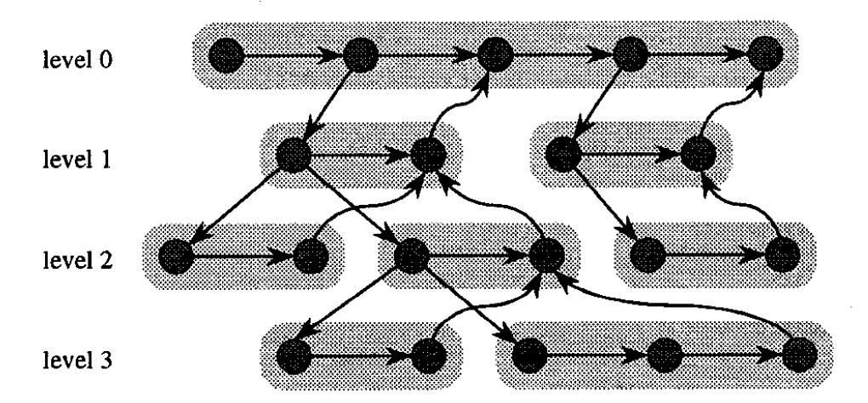



Directed Acyclic Graph(DAG)
Children
Successor
Data Dependency
Notes:
Cilk mtrltithreaded computation can be viewed as a directed
acyclic graph (dag) that unfolds dynamically, as is shown schematically
in Figure 1. A Cilk program consists of a collection of Cilk
procedures, each of which is broken into a sequence of threads, which
form the vertices of the dag. Each thread is a nonblocking C function,
which means that it can run to completion without waiting or suspending once it has been invoked

Slide 4
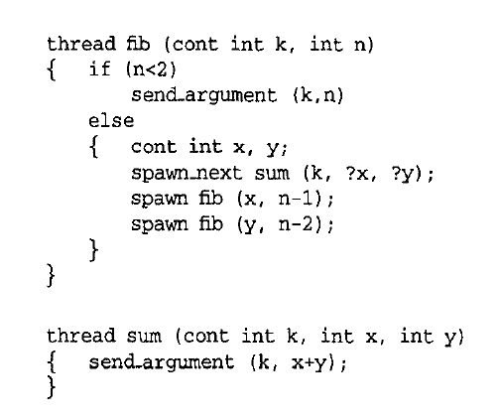
Advantage of Non-Blocking
Temporary Values on runtime stacks
Reduced context switching

Slide 5
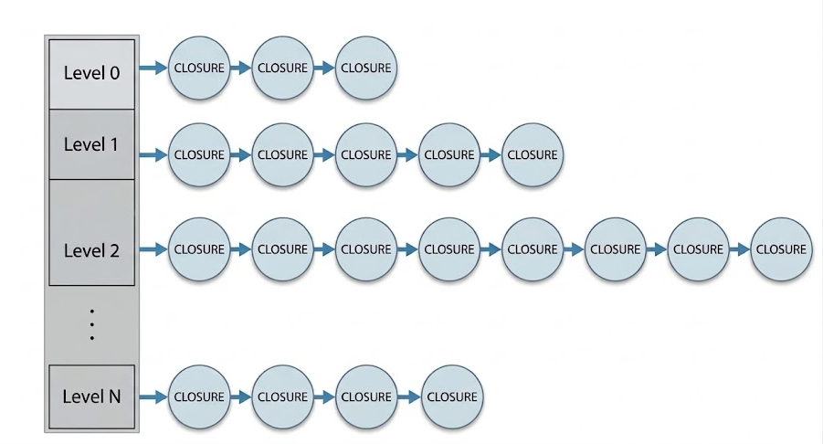
Work-Stealing Scheduler
A processor (thief) whom runs out of work selects another processor (victim) and steal its work.
A ready queue storing ready closures.
  Linked-list of differents levels of threads

Slide 6
Work-Stealing Scheduler
If queue is not empty:
  Start with the thread from the HEAD of the list of the deepest nonempty level
If queue is empty, the processor becomes thief:
  Repeatedly selects a processor until it queue is not empty
  Start with the thread from the TAIL of the list of the shallowest nonempty level
Should steal enough amount of work
Shallowest in the DAG

Slide 7
Spawning new threads
Extract the threads and invoke it.
Children
Successor
Data Dependency

Slide 8
Modeling Performance
For any given program:
Nearly perfect linear speed up when critical path is short compare with average amount of work per processor.
Work | T₁
Critical Path | T∞
P processors | T_{P}≈(T₁/P +c∞T∞), c∞≈1.5

Slide 9
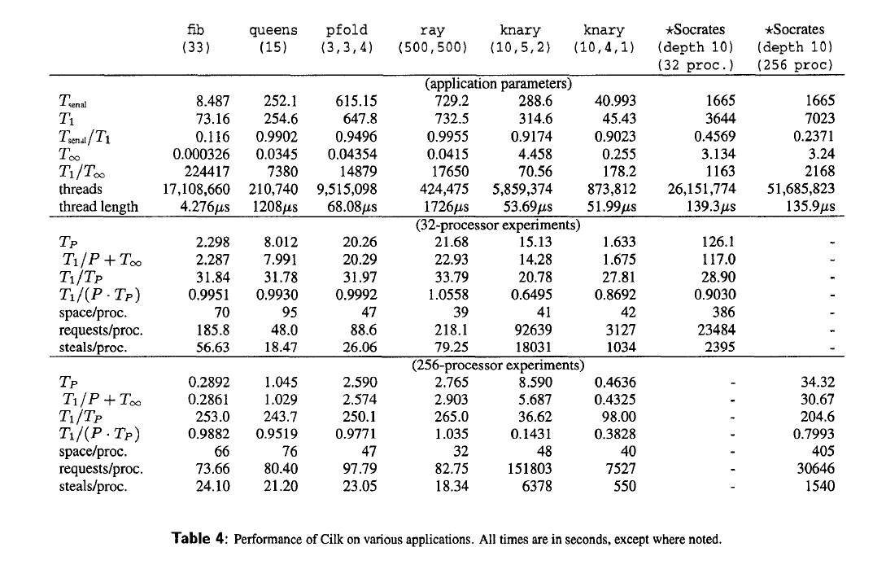
Notes:
Efficiency and thread length: benefits more when longer length. Not for socrates because of its speculative searching structure.

Slide 10
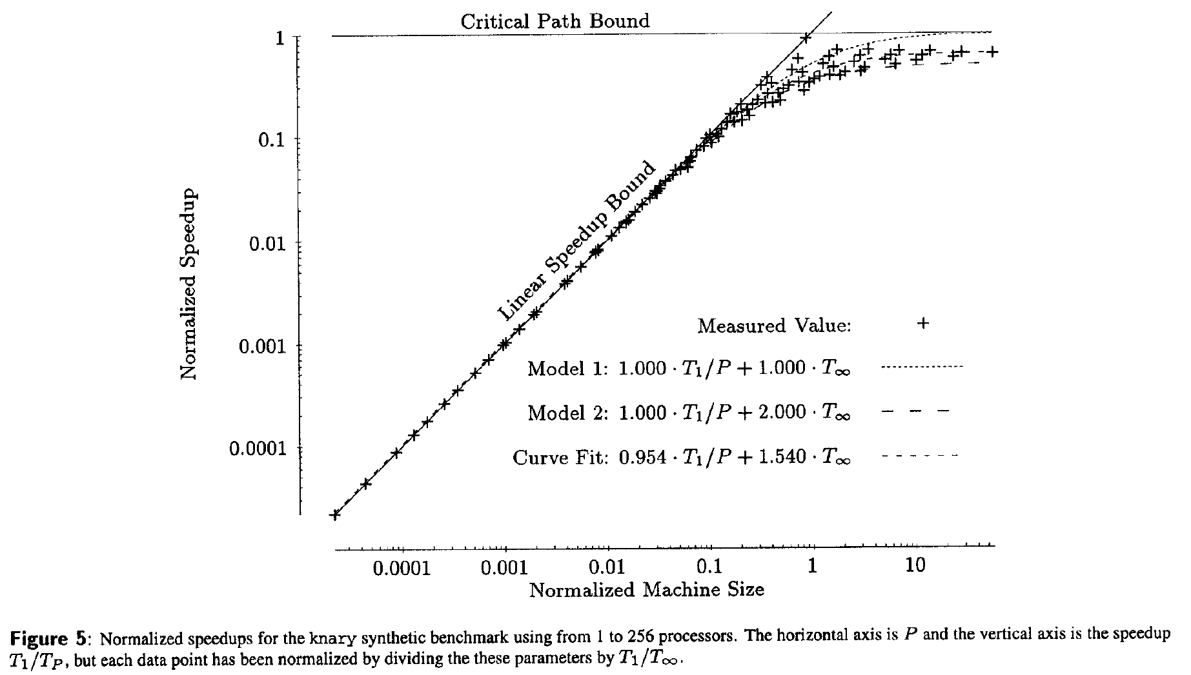

Slide 11
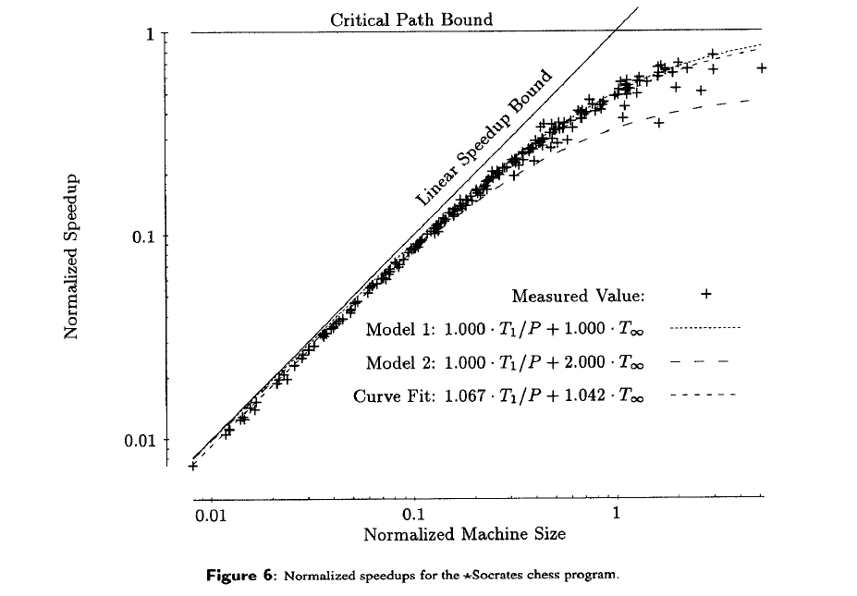

Slide 12
Theoretical Analysis
For the class of “Fully Strict” Cilk program:
Space: Sp <= S₁P, S₁ space for serial execution
Time: O(T₁/P + T∞)
Communication: O(T∞PS_{max})

Slide 13
Discussion: Work-Stealing & Memory locality
Stealing strategy
Hierarchical searching victim processors
Page Migration
Affinity Hints(Intel TBB): task placed at processor who have recently used the data, specifically for a certain processor rather than global pool
Advanced Schedulers(SLAW/X10):cluster with matching hardware topology

Slide 14
Extends to modern processors
Work-stealing scheduler: bounds, work from bottom, steal from top
Victim Selection: Hierarchical Level
Data movement: heat tracking, data “following” tasks
THE:two handle enqueue

